Slide 1
What you will be doing
No class Monday
Next class Wed in MLIB 1110
Read chapters 2 & 3.1-3.3 in text
Read chapter 2 Notes
In class Assignment 3 today
Complete Assignment 4 as really basic introduction to Matlab
Due 23rd

Slide 2
Programming Languages
Programs written in a specific language are just variations on ways to pass instructions to a computer
Each language has its own syntax (form) and semantics (meaning)
Syntax: Sequences of text including words, numbers, and punctuation using rules like written languages (grammar)
Semantics: The meaning given to the syntax - a sequence of words that makes sense to a computer

Slide 3

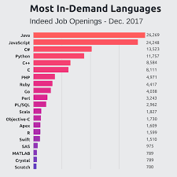
Matlab
Python
Proprietary
Inexpensive for educational uses, expensive otherwise
Flexible graphical user interface
Many toolboxes
Matrix oriented
Open source
Free, although enterprise releases for commercial applications
Notebooks are a convenient way to learn
Many modules
Object oriented

Slide 4
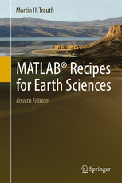
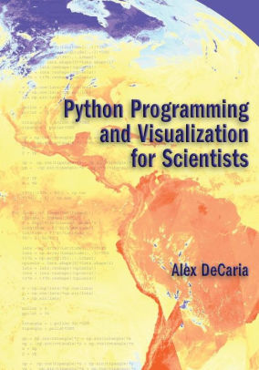
In this course:
Matlab
Python
All codes available in Matlab
What nearly everyone should use
Matlab text required
Nearly all codes available in python
Some may want to do some exercises using python
Intro text recommended
Everything in one github repository (notes, codes, data): https://github.com/johnhorel/atmos_5040_2019
Programming language reviews from ATMOS 5020 in repository
Notes independent of language
It may be possible to have additional lab time on Wednesdays after the official class period ends

Slide 5
The zen of programming
Understand what you are expected to do
Don’t start from scratch- use example codes or search for examples
Read text, look online for techniques and tricks
There is never only one way to do something- build on what you are comfortable with but seek simpler ways

Slide 6
Debugging
Programming is iterative
Start from what works.
Get example code working first
What did you change?
Have you looked at the underlying data file?
Have you looked at the workspace variables?
Did you display some intermediate values?
Don’t assume that if your code runs that it is correct. Does the output make sense?
Don’t expect others to debug your code for you
Programming can be like solving a puzzle- it appears hard while you’re doing it, but you get some great “ah ha” moments once you’ve figured it out for yourself
Being able to work independently and solve problems is critical

Slide 7
Running Matlab
Find Matlab using the Mac search tool
What is the directory shown?
Change the directory to your desktop
Becoming comfortable with the Matlab environment
Command window
Workspace
Editor
Current Folder

Slide 8
Using github class directory
Go to https://github.com/johnhorel/ATMOS_5040_2019
Note the directory “programming help matlab”
Go to the main class directory
Select the clone/download tab
Select the download zip tab
On your Mac, move the zip file to the Desktop and then unzip it
Go to the Chapter 2 subdirectory
Double click on the jan16_inclass.m file
Matlab should start up

Slide 9
1.1 Starting MATLAB, MATLAB Windows
Workspace Window
Current Folder Window
Command History Window
Command Window

Slide 10
1.1 Starting MATLAB, MATLAB Windows
Window | Purpose
Command Window | Main window, enters variables, runs programs.
Figure Window | Contains output from graphic commands.
Editor Window | Creates and debugs script and function files.
Help Window | Provides help information.
Command History Window | Logs commands entered in the Command Window.
Workspace Window | Provides information about the variables that are stored.
Current Folder Window | Shows the files in the current folder.

Slide 11
1.2 Working in the Command Window
Command Window is MATLAB’s main window. Use it to:
Execute commands
Open other windows
Run programs that you’ve written
Manage the MATLAB software
ver- version. What version of Matlab is installed and toolboxes available

Slide 12
1.2 Working in the Command Window
Basic procedure
At prompt (>>), type in MATLAB command
Press ENTER key
MATLAB displays result in Command Window, followed by a prompt
Repeat from step 1

Slide 13
1.1 Starting MATLAB, MATLAB Windows
Use Editor Window to write and debug MATLAB scripts. Open with edit command

Slide 14
1.8.1 Notes About Script Files
A script file/program/m file is a sequence of MATLAB commands
When a program runs (is executed), MATLAB performs the commands in the order they are written, just as if they were typed in the Command Window
When a script file has a command that generates an output (e.g. assignment of a value to a variable without semicolon at the end), the file displays the output in the Command Window

Slide 15
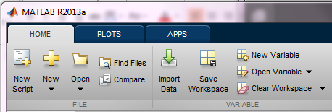
1.8.2 Creating and Saving a Script File
Use the Editor Window to work with script files
Can open window and create file two ways
Click on New Script icon
Click on New icon, select Script
In the Command Window, type edit and then press ENTER

Slide 16
1.8.2 Creating and Saving a Script File
Editor has tool strip on top with three tabs – EDITOR, PUBLISH, VIEW
MATLAB used most often with EDITOR tab selected

Slide 17
1.8.4 Current Folder
The current folder is the folder that MATLAB checks first when looking for your script file
Can see current folder in desktop toolbar
Can also display current folder by issuing MATLAB command pwd

Slide 18
1.8.4 Current Folder
Can change current folder in Current Folder Window
To show Current Folder Window, click on Layout icon in desktop, then select Current Folder

Slide 19
Matlab File Names and Headers
Every matlab file you create or edit should contain your name, the date it was created or last edited and a brief description of what the file solves.
Remember that many assignments require several files. This guideline applies to all of them.
Your output in the Command Window should contain your name, the date, course, assignment number, what it does, and what other routines and data files are required. This rule and the previous rule can be accomplished with a single set of commands.
disp(' ')
disp(' ')
disp(' John Horel')
disp(' ATMOS 5040/ Spring 2019')
disp(' Chapter 2')
disp(' Reproducing code in notes')
Disp(‘Requires XXX data file’)

Slide 20
Comments
Each program should include sufficient comments that the major steps can be followed by a user with a knowledge level equal to your own.
This doesn’t mean each line of code must be commented necessarily. Blocks of code that perform some operation can be commented together.
Include info on units on numerical values in the code

Slide 21
Graphs
Basic guidelines of proper graphing (labels, symbol types, titles, legend, etc.) should be followed
Save in a common format (png)
Include your name and date in the title of every figure to be turned in

Slide 22
Features for Plotting
figure
plot - Linear plot.
subplot
loglog - Log-log scale plot.
semilogx - Semi-log scale plot.
semilogy - Semi-log scale plot.
axis - Control axis scaling and appearance.
hold - Hold current graph.
title - Graph title.
xlabel - X-axis label.
ylabel - Y-axis label.
get - Gets plot properties.
set - Sets plot properties.
grid
Color Line Type Marker Type
y - yellow - - solid . - point
m - magenta : - dotted o - circle
c - cyan -. - dashdot x - x-mark
r - red -- - dashed + - plus
g - green * - star
b - blue s - square
w - white d - diamond
k - black v - triangle (down)
^ - triangle (up)
< - triangle (left)
> - triangle (right
p - pentagram
h - hexagram

Slide 23
Output
Output should be formatted as to be easily readable.
Use tabular data when appropriate.
Include units and report values to the proper number of significant figures.

Slide 24
Section 1.4 Display Formats
Can control display of numbers with format command
Once enter command, format stays the same until another format command
Default format is fixed point with four digits to right of decimal point
fixed-point means decimal point always between one’s-digit and one-tenth’s digit
Format only affects display of numbers. MATLAB always computes and saves numbers in full precision

Slide 25
Saving as pdf and uploading to Canvas
Click on the “Publish” tab
Choose “Edit Publishing Options”
Change the “Output File Format” to pdf
Run the program again
Verify that the pdf output contains the code and figure with your name on it

Slide 26
January 16 In-class assignment
%clear all the variables
clear all
%close all the figure windows
close all
% jan16 2019 inclass assignment
disp(' ')
disp(' ')
disp(' John Horel')
disp(' ATMOS 5040/ Spring 2019')
disp(' January 16 inclass assignment')
disp(' Requires alta_snow.csv')

Slide 27
January 16 In-class assignment
%for info on the data
%http://utahavalanchecenter.org/alta-monthly-snowfall
%download the data from the class github repository
data = csvread('../data/alta_snow.csv');
%column 1 is the year and column 8 is the seasonal total
%create a vector of the years
yr = data(:,1);
%find out how many years
ny = length(yr);
%convert the seasonal totals from inches to cm
tot = data(:,8)*2.54;

Slide 28
January 16 In-class assignment
%compute the means of each column
mmn = mean(data);
% determine max value and index value of max for the winter season
[maxs,mxi] = max(tot);
% write to screen the year when max occurred
fprintf('year of max seasonal snowfall and amount %d %.1f cm\n', yr(mxi),maxs)
%repeat for min
[mins,mni] = min(tot);
fprintf('year of min seasonal snowfall and amount %d %.1f cm\n', yr(mni),mins)

Slide 29
January 16 In-class assignment
%plot time series of snow totals as bar chart
figure(1)
bar(yr,tot)
axis('tight')
title('Alta water year snow total (cm) John Horel 12/30/2018')
xlabel('Year')
ylabel('Snow total (cm)')
grid
%then be sure to publish as a pdf and upload to canvas

Slide 30
Same thing in python!
Look online in https://github.com/johnhorel/atmos_5040_2019/tree/master/chapter%202
Double click on: jan16_2019_inclass.ipynb

Slide 31
What you will be doing
No class Monday
Next class Wed in MLIB 1110
Read chapters 2 & 3.1-3.3 in text
Read chapter 2 Notes
In class Assignment 3 today: upload your matlab pdf to canvas
Complete Assignment 4 as really basic introduction to Matlab
Due 23rd

Slide 32
Matlab reference material

Slide 33
1.3 Arithmetic Operations with Scalars
Symbols for arithmetic are:
Operation | Symbol | Example
Addition | + | 5 + 3
Subtraction | – | 5 – 3
Multiplication | * | 5 * 3
Right division | / | 5 / 3
Exponentiation | ^ | 5 ^ 3 (means 5³ = 125)

Slide 34
1.3.1 Order of Precedence
Order in which MATLAB does arithmetic
Precedence | Mathematical Operation
First | Parentheses. For nested parentheses, the innermost are executed first.
Second | Exponentiation.
Third | Multiplication, division (equal precedence).
Fourth | Addition and subtraction.

Slide 35
Boolean and Logical operators
== Equal
~= Not equal
< Less than
> Greater than
& Logical AND
| Logical OR
~ Logical NOT

Slide 36
Syntax
if - Conditionally execute statements.
else - IF statement condition.
elseif - IF statement condition.
end - Terminate scope of FOR, WHILE, SWITCH, TRY and IF statements.
for - Repeat statements a specific number of times.
while - Repeat statements an indefinite number of times.
break - Terminate execution of WHILE or FOR loop.
continue - Pass control to the next iteration of FOR or WHILE loop.
function - Add new function.
return - Return to invoking function.
error - Display error message and abort function.
disp - Display an array.
feval - Execute function specified by string.

Slide 37
Math
sin - Sine.
asin - Inverse sine.
cos - Cosine.
acos - Inverse cosine.
tan - Tangent.
atan - Inverse tangent.
atan2 - Four quadrant inverse tangent.
sqrt - Square root.
exp - Exponential.
log - Natural logarithm.
log10 - Common (base 10) logarithm.
factorial - Factorial function.
abs - Absolute value.
conj - Complex conjugate.
real - Complex real part.
imag - Complex imaginary part.
floor - Round towards minus infinity.
ceil - Round towards plus infinity.
round - Round towards nearest integer.
mod - Modulus.
norm - Matrix or vector norm.
det - Determinant.
inv - Matrix inverse.
eig - Eigenvalues and eigenvectors.
cross - Vector cross product.
Dot – vector dot product

Slide 38
1.5 Elementary Math Built-in Functions
Rounding functions
round(x) – round to nearest integer
fix(x) – round toward zero
ceil(x) – round toward infinity
floor(x) – round toward minus infinity
rem(x,y) – remainder after x is divided by y (also called modulus)
sign(x) – returns 1 if x is positive, -1 if x is negative, zero if x is zero

Slide 39
1.6 Defining Scalar Variables
A variable is a name that is assigned a numerical value
Once assigned, can use variable in expressions, functions, and MATLAB statements and commands
Can read the variable (get its value)
Can write to the variable (set its value)

Slide 40
2.0
An array is MATLAB's basic data structure
Can have any number of dimensions. Most common are
vector - one dimension (a single row or column)
matrix - two or more dimensions
Arrays can contain numbers or letters

Slide 41
Matlab terminology
Scalar: 1x1
Vector: m x 1 (m rows); 1 x n (n columns)
Transpose (‘) flips vectors;
Matrix: m x n
Cell arrays: numerically indexed aggregates of info

Slide 42
2.3 Notes About Variables in MATLAB
All variables are arrays
Scalar - array with only one element
Vector - array with only one row or column
Matrix - array with multiple rows and columns
Assigning to variable specifies its dimension
Don't have to define variable size before assigning to it, as you do in many programming languages
Reassigning to variable changes its dimension to that of assignment

Slide 43
Variable Names and Code Structure
Effective use of variable names can minimize the need for comments.
Variable names that are descriptive should be used whenever possible.
Use spaces and indents to improve the readability of your code.
When input is requested from the user, the units need to be included in the request on the screen, and the format of the input should be specified.

Slide 44
1.6.1 The Assignment Operator
= means “assign to” or “store in” but not “equals”!
= (equals sign) is MATLAB’s assignment operator. It evaluates the expression on its right side and stores the resulting value in the variable on its left side
x = x + 6 means “take whatever is in x, add 6 to that and store the result back into x”

Slide 45
2.1 Creating a One-Dimensional Array (Vector)
To create a row vector from known numbers, type variable name, then equal sign, then inside square brackets, numbers separated by spaces and/or commas
variable_name = [ n1, n2, n3 ]
>> yr = [1984 1986 1988 1990 1992 1994 1996]
yr =
1984 1986 1988 1990 1992 1994 1996
Commas optional
Note MATLAB displays row vector horizontally

Slide 46
2.1 Creating a One-Dimensional Array (Vector)
To create a column vector from known numbers
Method 1 - same as row vector but put semicolon after all but last number
variable_name = [ n1; n2; n3 ]
>> yr = [1984; 1986; 1988 ]
yr =
1984
1986
1988
Note MATLAB displays column vector vertically

Slide 47
2.4 The Transpose Operator
Transpose a variable by putting a single quote after it, e.g., x'
In math, transpose usually denoted by superscript "T", e.g., x^{T}
Converts a row vector to a column vector and vice-versa
Switches rows and columns of a matrix, i.e., first row of original becomes first column of transposed, second row of original becomes second column of transposed, etc.

Slide 48
2.2.1 The zeros, ones and, eye Commands
zeros(m,n) - makes matrix of m rows and n columns, all with zeros
ones(m,n) - makes matrix of m rows and n columns, all with ones
eye(n) - makes square matrix of n rows and columns. Main diagonal (upper left to lower right) has ones, all other elements are zero

Slide 49
2.2.1 The zeros, ones and, eye Commands
>> idn=eye(5)
idn = 1 0 0 0 0
0 1 0 0 0
0 0 1 0 0
0 0 0 1 0
0 0 0 0 1
>> zr=zeros(3,4)
zr = 0 0 0 0
0 0 0 0
0 0 0 0
>> ne=ones(4,3)
ne = 1 1 1
1 1 1
1 1 1
1 1 1

Slide 50
2.2.1 The zeros, ones and, eye Commands
To make a matrix filled with a particular number, multiply ones(m,n) by that number
>> z=100*ones(3,4)
z =
100 100 100 100
100 100 100 100
100 100 100 100

Slide 51
2.5.1 Vector
Address of element is its position in the vector
"address" often called index
Addresses in Matlab always start at 1 (not 0)
Address 1 of row vector is leftmost element
Address 1 of column vector is topmost element
To access element of a vector represented by a variable, follow variables name by address inside parentheses, e.g., v(2)=20 sets second element of vector v to 20

Slide 52
2.6 Using a Colon : in Addressing Arrays
The colon : lets you address a range of elements
Vector (row or column)
va(:) - all elements
va(m:n) - elements m through n
Matrix
A(:,n) - all rows of column n
A(m,:) - all columns of row m
A(:,m:n) - all rows of columns m through n
A(m:n,:) - all columns of rows m through n
A(m:n,p:q) - columns p through q of rows m through n

Slide 53
Keeping Things Straight
: Span operator [1:5] = [1 2 3 4 5]
( ) Operation grouping
[ ] Vector and matrix delimiter
{} Cell delimiter
. Decimal point
.. Parent directory
... Continuation of command to next line
, Separator
; End line or row
% Comment
= Assignment operator
’ - String delimiter

Slide 54
2.9 Built-in Functions for Handling Arrays
MATLAB has many built-in functions for working with arrays. Some common ones are:
length(v) - number of elements in a vector
size(A) - number of rows and columns in a matrix or vector
reshape(A,m,n) - changes number of rows and columns of a matrix or vector while keeping total number of elements the same. For example, changes 4x4 matrix to 2x8 matrix

Slide 55
2.9 Built-in Functions for Handling Arrays
diag(v) - makes a square matrix of zeroes with vector in main diagonal
diag(A) - creates vector equal to main diagonal of matrix
For more functions, click on the Help icon, then in the Help window click on MATLAB, then on “MATLAB functions”, then on “By Category", then scroll down to the section labeled "Matrices and Arrays"

Slide 56
3.1 Addition and Subtraction
Use + to add two arrays or to add a scalar to an array
Use – to subtract one array from another or to subtract a scalar from an array
When using two arrays, they must both have the same dimensions (number of rows and number of columns)
Vectors must have the same dimensions (rows and columns), not just the same number of elements

Slide 57
3.1 Addition and Subtraction
When adding two arrays A and B, MATLAB adds the corresponding elements, i.e.,
It adds the element in the first row and first column of A to the element in the first row and column of B
It adds the element in the first row and second column of A to the element in the first row and second column of B, etc.
This called elementwise addition

Slide 58
3.1 Addition and Subtraction
When subtracting two arrays A and B, MATLAB performs an elementwise subtraction
In general, an operation between two arrays that works on corresponding elements is called an elementwise operation

Slide 59
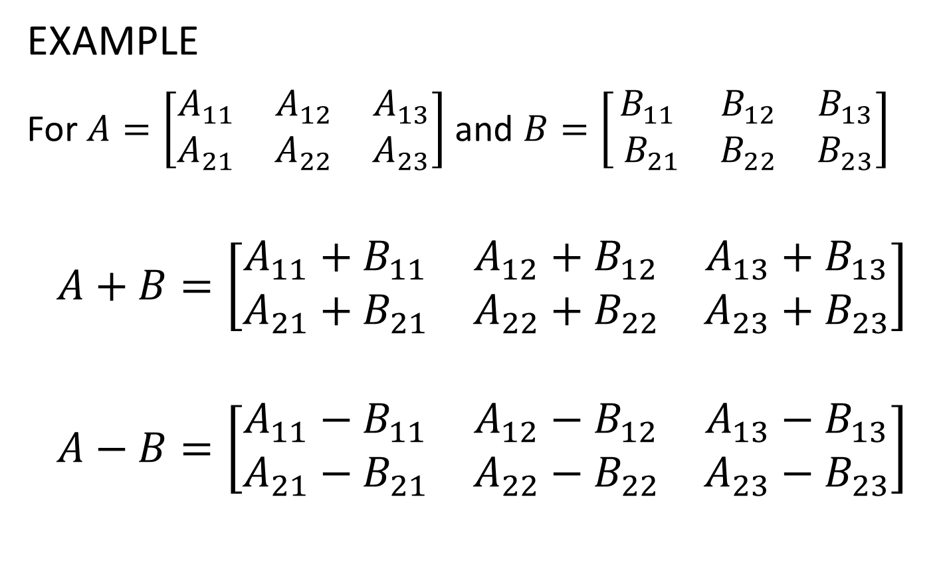
3.1 Addition and Subtraction
EXAMPLE
For $A=\left[\begin{matrix}A_{11} & A_{12} & A_{13} \\ A_{21} & A_{22} & A_{23}\end{matrix}\right]$and $B=\left[\begin{matrix}B_{11} & B_{12} & B_{13} \\ { B}_{21} & B_{22} & B_{23}\end{matrix}\right]$
$$A+B=\left[\begin{matrix}A_{11}+B_{11} & A_{12}+B_{12} & A_{13}+B_{13} \\ A_{21}+B_{21} & A_{22}+B_{22} & A_{23}+B_{23}\end{matrix}\right]$$
$$A−B=\left[\begin{matrix}A_{11}−B_{11} & A_{12}−B_{12} & A_{13}−B_{13} \\ A_{21}−B_{21} & A_{22}−B_{22} & A_{23}−B_{23}\end{matrix}\right]$$

Slide 60
3.1 Addition and Subtraction
When adding a scalar to an array, MATLAB adds the scalar to every element of the array
When subtracting a scalar from an array, MATLAB subtracts the scalar from every element of the array

Slide 61
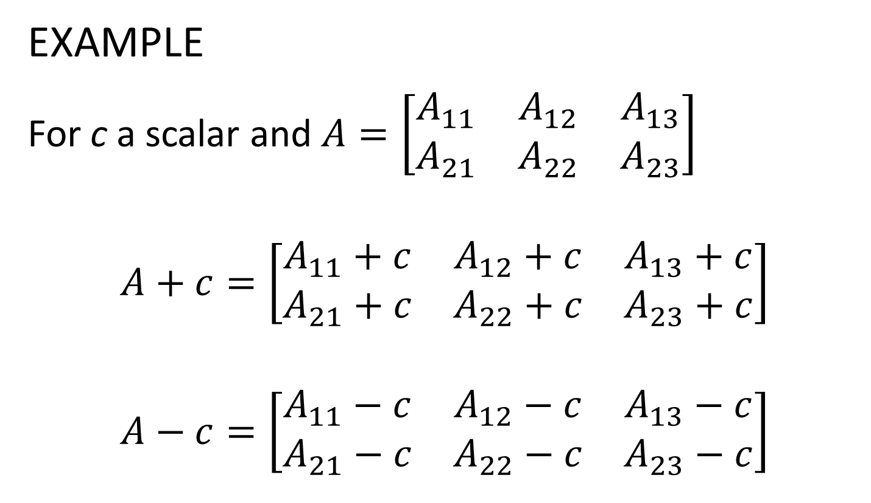
3.1 Addition and Subtraction
EXAMPLE
For c a scalar and $A=\left[\begin{matrix}A_{11} & A_{12} & A_{13} \\ A_{21} & A_{22} & A_{23}\end{matrix}\right]$
$$A+c=\left[\begin{matrix}A_{11}+c & A_{12}+c & A_{13}+c \\ A_{21}+c & A_{22}+c & A_{23}+c\end{matrix}\right]$$
$$A−c=\left[\begin{matrix}A_{11}−c & A_{12}−c & A_{13}−c \\ A_{21}−c & A_{22}−c & A_{23}−c\end{matrix}\right]$$

Slide 62
3.2 Array Multiplication
There are two ways of multiplying matrices – matrix multiplication and elementwise multiplication
MATRIX MULTIPLICATION
Type used in linear algebra
MATLAB denotes this with asterisk (*)
Number of columns in left matrix must be same as number of rows in right matrix

Slide 63
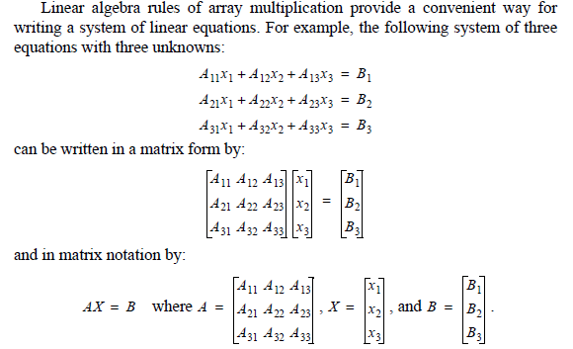
3.2 Array Multiplication

Slide 64
3.2 Array Multiplication

Slide 65
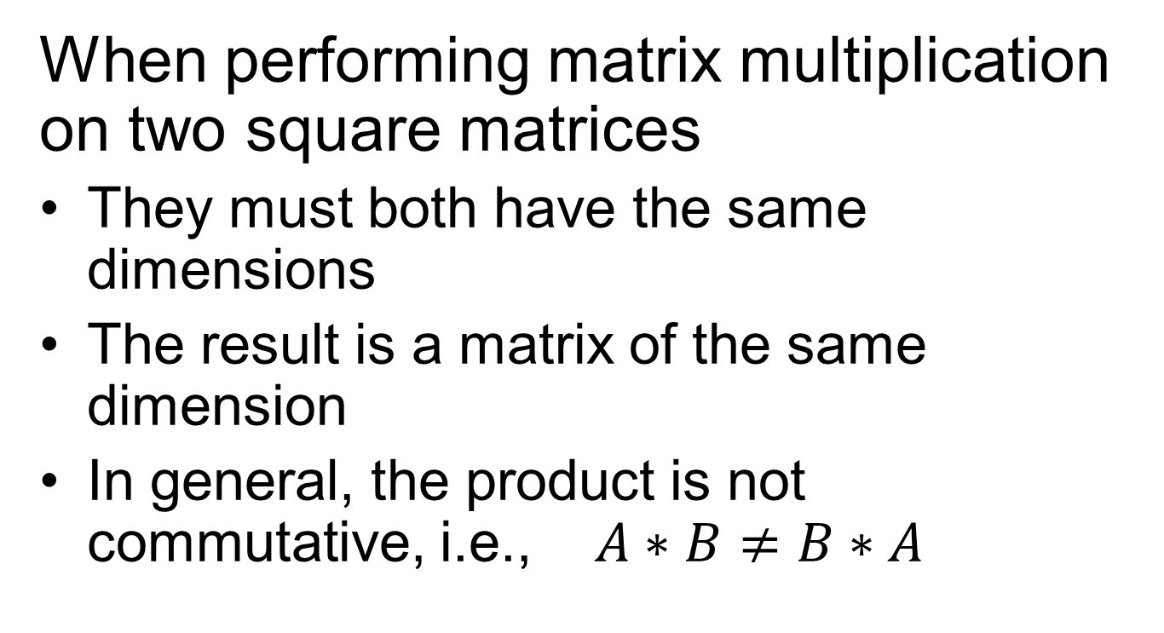
3.2 Array Multiplication
When performing matrix multiplication on two square matrices
They must both have the same dimensions
The result is a matrix of the same dimension
In general, the product is not commutative, i.e., $A∗B≠B∗A$

Slide 66
3.2 Array Multiplication
>> A = randi(3,3)
A =
3 3 1
3 2 2
1 1 3
>> B=randi(3,3)
B =
3 3 1
1 2 2
3 3 3
>> AB = A*B
AB =
15 18 12
17 19 13
13 14 12
>> BA = B*A
BA =
19 16 12
11 9 11
21 18 18
>> AB == BA
ans =
0 0 1
0 0 0
0 0 0

Slide 67
3.2 Array Multiplication
When performing matrix multiplication on two vectors
They must both be the same size
One must be a row vector and the other a column vector
If the row vector is on the left, the product is a scalar
If the row vector is on the right, the product is a square matrix whose side is the same size as the vectors

Slide 68
3.2 Array Multiplication
>> h = [ 2 4 6 ]
h =
2 4 6
>> v = [ -1 0 1 ]'
v =
-1
0
1
>> h * v
ans =
4
>> v * h
ans =
-2 -4 -6
0 0 0
2 4 6

Slide 69
3.4 Element-by-Element Operations
Another way of saying elementwise operations is element-by-element operations
Addition and subtraction of arrays is always elementwise
Multiplication, division, exponentiation of arrays can be elementwise
Both arrays must be same dimension

Slide 70

3.4 Element-by-Element Operations
Do elementwise multiplication, division, exponentiation by putting a period in front of the arithmetic operator

Slide 71
3.4 Element-by-Element Operations
ELEMENTWISE MULTIPLICATION
Use .* to get elementwise multiplication (notice period before asterisk)
Both matrices must have the same dimensions
>> A = [1 2; 3 4];
>> B = [0 1/2; 1 -1/2];
>> C = A .* B
>> C =
0 1
3 -2

Slide 72
3.4 Element-by-Element Operations
If matrices not same dimension in elementwise multiplication, MATLAB gives error
>> A = [ 1 2; 3 4];
>> B = [1 0]';
>> A .* B % Meant matrix multiplication!
??? Error using ==> times
Matrix dimensions must agree.
>> A * B % this works
ans =
1
3

Slide 73
3.4 Element-by-Element Operations
Be careful – when multiplying square matrices
Both types of multiplication always work
If you specify the wrong operator, MATLAB will do the wrong computation and there will be no error!
Difficult to find this kind of mistake

Slide 74
3.4 Element-by-Element Operations
Elementwise computations useful for calculating value of a function at many values of its argument

Slide 75
3.6 Built-in Functions for Analyzing Arrays
MATLAB has lots of functions for operating on arrays. For a vector v
mean(v) – mean (average)
max(v) – maximum value, optionally with index of maximum
min(v) – minimum value, optionally with index of minimum
sum(v) – sum
sort(v) – elements sorted into ascending order

Slide 76
3.6 Built-in Functions for Analyzing Arrays
median(v) – median
std(v) – standard deviation
dot(v,w) – dot (inner product); v, w both vectors of same size but any dimension
cross(v,w) – cross product; v, w must both have three elements but any dimension
det(A) – determinant of square matrix A
inv(A) – inverse of square matrix A

